Slide 1
Social & Economic Rights Fulfillment Index
Holding Governments Accountable
Susan Randolph
University of Connecticut

Slide 2
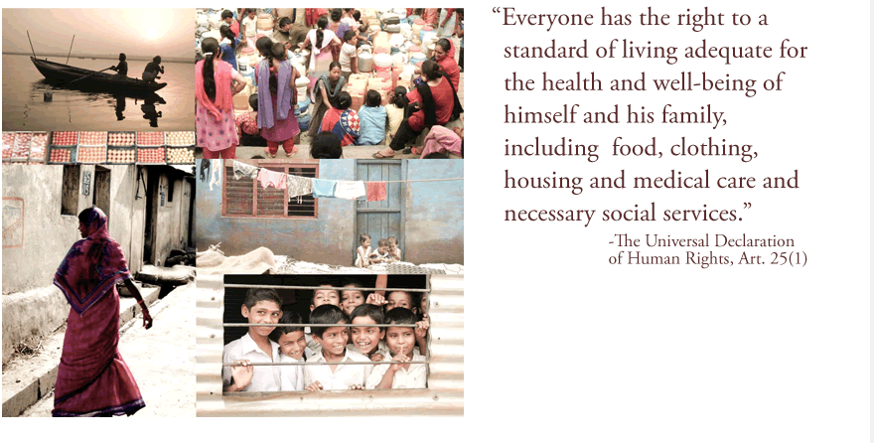
The Economic & Social Rights Empowerment Initiative www.serfindex.org
Notes:
The Economic and Social Rights Empowerment Initiative provides rigorous quantitative tools and analysis to assess the extent to which countries are meeting their obligations of results with regard to economic, social and cultural rights.
The Initiative also undertakes analysis to identify the sorts of policies and programs that facilitate the realization of ESR, and supports in-depth country case studies of human rights outcomes and their policy origins, facilitates information sharing related to the political economy of ESR fulfillment.
The Co-directors of the initiative are myself, a Prof. at Uconn, and Sakiko Fukuda-Parr and Terra Lawson-Remer, both professors at The New School in NYC, in collaboration with the Social Science Research Council.
At the core of the initiative is the Social and Economic Rights Fulfillment Index—SERF Index for short—an innovative index that can be used to hold governments accountable to their obligations of result under the ICESCR.
The Initiative is supporting in-dept country case studies of human rights outcomes and their policy origins, and is currently looking to identify groups that would be interested in using the SERF Index and/or its methodology to further their work.
In particular, we envision working collaboratively with them to develop a multi-group, multi-country grant proposal to fund their work in this vein.

Slide 3
The SERF Index Approach
SERF Index Methodology
Core & High Income Country SERF Index
Historical SERF Index
Application to the USA
Notes:
1. What I’d like to do today is to first provide an overview of the SERF Index Methodology.
2. Then, I’d like to introduce our main index and our historical index, the application of the methodology to a case study of the USA, and along the way, show you the sorts of things the SERF Index reveals.

Slide 4
The SERF Index Methodology
Notes:
So, what is this methodology?

Slide 5
General Approach
Principle of progressive realization→countries commit maximum of available resources to fulfill economic and social rights.
Zi = right enjoyment level / state obligation level
    Socio-economic indicators assess enjoyment
    Achievement Possibility Frontiers assess state capacity
Notes:
The “ Principle of Progressive Realization” enunciated in Article 2.1 of the ICESCR requires countries to commit the maximum of their available resources to fulfill their economic and social rights obligations.
Thus in assessing the extent to which countries meet their obligations of result, one needs to assess the level of rights enjoyment relative to the level of the country’s obligation of results.
In essence, this is what the SERF Index does. It measures a country’s ESR fulfillment score on any given right, call it z, as the ratio between the level of rights enjoyment and the level of state obligation which after multiplying by 100 reflects the percentage to which the country has met its obligation.
Thus in constructing the SERF Index with regard to any aspect of a given ESR, two pieces of information are required:
A measure of the extent to which the right is enjoyed (the numerator), and
A measure of the extent of the State’s obligation with regard to the extent to which the right is enjoyed (the denominator).

Slide 6
Measuring Rights Enjoyment
For each substantive right
  the right to food,
  right to adequate shelter,
  right to health care,
  right to education,
  Right to decent work,
  right to social security.
Identify socio-economic indicators reflecting relevant aspects of right
  Objective survey based data
Notes:
We identify the substantive rights specified from the text of the Covenant along with the CESCR’s General Comments.
We then select socio-economic indicators reflecting the most relevant attributes of the substantive rights to measure the level of rights enjoyment.
Beyond concept validity, a number of additional criteria govern our choice of indicators including data reliability, comparability across countries and over time, and whether the indicator was based on objective information and generated using an objective method.
The indicators selected vary depending on the context.
Selection of indicators for our international indices requires striking a balance between several factors:
Coverage across countries or other relevant administrative unit, the most relevant challenges to fulfilling a right, discrimination in achievement, and the like.
As a result, the selection of indicators measuring rights enjoyment varies across the applications we’ll look at today.
In all cases, though, we restrict our choice to data that is publicly accessible and to the extent possible harmonized by international organizations—eg. UN, World Bank, etc..
Of course, we can’t adjust for intentional inaccuracies in data reports by governments.

Slide 7
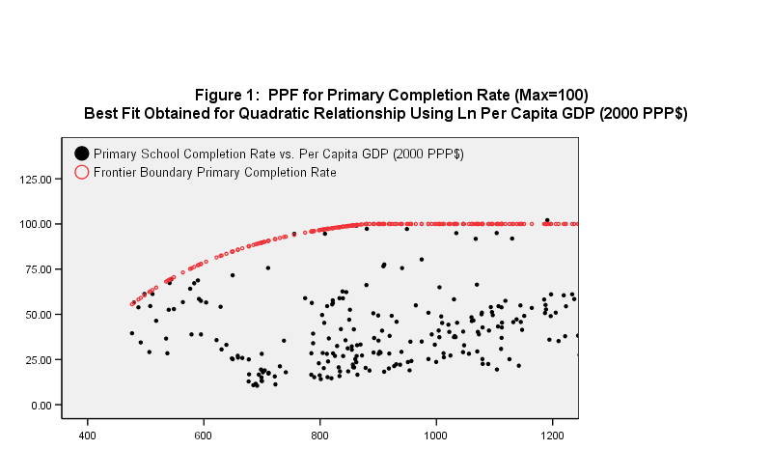
Achievement Possibilities Frontiers
APF for Primary School Completion Rate
Notes:
The key innovation of the SERF Index methodology is the construction of an Achievement Possibility Frontier for each indicator that benchmark’s each country’s level of obligation at any time.
In the case of our international indices, we construct a scatter plot of achievement on a given indicator against per capita GDP (measured in constant PPP$), our indicator of available resources, using data from all countries over the 1990-2008 period.
We then identify frontier observations from the scatter and use econometric techniques to fit a cuvre to the boundary observations.
The resultant Achievement Possibility Frontier shows the level of achievement on an indicator that is feasible using best practices at any given level of resource capacity.
What’s striking about the frontiers, is the large difference in rights enjoyment levels among countries with similar per capita GDP levels.
A country’s level of obligation at a given time with regard to any given aspect of a right is then measured as the frontier value of the Achievement Possibility Frontier at the country’s per capita GDP level.
A performance indicator score is then calculated as the ratio of the level of enjoyment observed in a country at a given time to the feasible level at that country’s per capita income level.

Slide 8
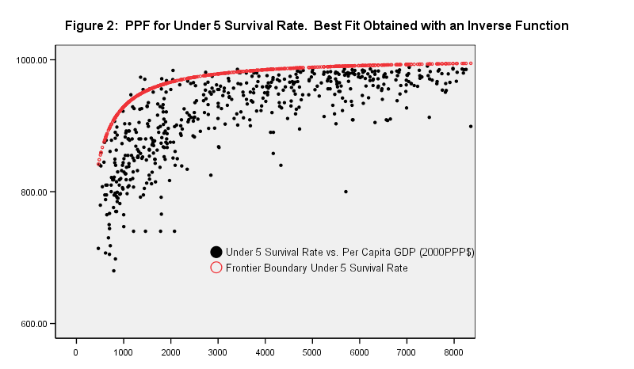
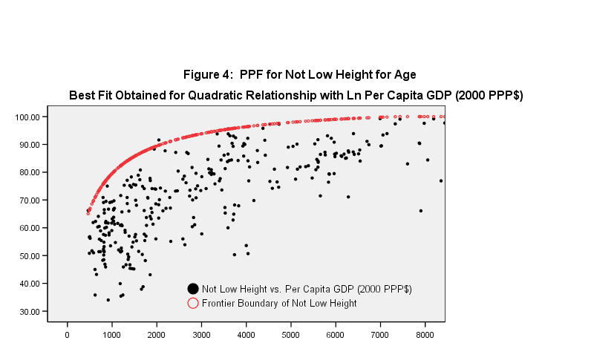
Frontier Shapes and
Plateau per capita GDP Level Differ
Notes:
It is also clear that it is feasible to fulfill some aspects of some rights at lower per capita income levels than others.
For example, it takes 10 times more income to achieve the maximum score on the percentage of children not stunted than it does to achieve a 100% primary school completion rate.
The frontiers map the rate at which it is feasible to transform resources into aspects of rights enjoyment.

Slide 9
Construction of the SERF Index
APF 1
Indicator Performance Score 1
Indicator 1
Right Index
Average
APF 2
Indicator Performance Score 2
Indicator 2
Weighted Average of Right Indices
SERF Index
Notes:
The SERF Index is constructed as follows:
[Click on 1]. An indicator of a right aspect is converted into an indicator performance score for that right aspect using the Achievement Possibilities Frontier as I just explained.
[Click on 2]. Since multiple aspects of a right are typical taken into account, each of the indicators underlying each aspect also need to be converted into performance indicator scores.
[Click on 3]. The performance indicator scores are then averaged to create a given right index.
[Click on 4]. The SERF Index itself is a weighted average of the different right indices.

Slide 10
Core & High Income Country SERF Indices
Notes:
What we refer to as THE SERF Index is actually a set of two indices, our Core Index for most countries, and a supplementary index for high income OECD countries.

Slide 11
Indicators of Rights Enjoyment Level by Right
Social/Economic Right | Indicator for Core SERF Index | Indicator for High Income OECD Country SERF Index
Right to Food | % children (0-5) NOT Malnourished (height for age) | %Infants NOT low birth weight
Right to Education | Primary school completion rate; Combined school enrollment rate | Combined school enrollment rate; Average math and science PISA score
Right to Health | Child Survival Rate (%); Age 65 Survival Rate (%); Contraceptive Use Rate | Child Survival Rate (%); Age 65 Survival Rate (%)
Right to Adequate Housing (incorporates Right to Water) | Access to improved water source (% rural population); Access to improved sanitation (% total population) | Data not available.
Right to decent work | % NOT absolutely poor (> $2 a day (2005 PPP); | % NOT relatively poor (> 50% median income); % not long term unemployment (% employed;
Right to social security | Data not available | Data not available
Notes:
The indicators used in the construction of our two variants differ in view of both the different relevant challenges faced, and the different types of data available for the two sets of countries.
Data limitations prevented us from including the right to social security in either variant at this time;
Nor, in the case of our supplementary index, were we able to include the right to adequate housing.
As data constraints are relaxed over time, we plan to include all six rights as well as indicators of a wider range of aspects of each right.

Slide 12
Mean Score on SERF Index
Notes:
We are able to compute the Core SERF Index for 98 countries and the Supplementary Index for High Income OECD countries for another 23 countries.
However, we can compute the underlying right indices for a larger number of countries as the figures in parentheses show.
The mean score across all countries on the Core SERF Index is just shy of 72%.
The mean score on the High Income OECD Country variant of the index is substantially higher, just under 90%.
There is variation in the mean score across the different right indices.
For Core countries, the range is 71% to 79% for the right to food and the right to education respectively.
For High income OECD countries, the range is larger--62% to nearly 98% for the right to work and education, respectively.

Slide 13
Core SERF Index
SCORE ON INDEX (%)
90-100 | 75-89.9 | 50-74.9 | 25-49.9 | 0-24.9
10 countries | 45 countries | 37 countries | 7 countries | 1 country
Uruguay, Jordan, Belarus, Moldova, Kyrgyz Republic, Cuba, Ukraine, Chile, Serbia | Jamaica, Guyana, Bulgaria, Argentina, Brazil, Georgia, Kazakhstan, Tunisia, Malaysia, Thailand, Armenia, Russian Federation, Albania, Iran, Mexico, Turkey, Romania, Dominican Republic, Sri Lanka, Paraguay, Macedonia, Ecuador, Liberia, Algeria, The Gambia, Belize, Nicaragua, Egypt, Venezuela, El Salvador, Tajikistan, China, Colombia, Vietnam, Uzbekistan, Trinidad and Tobago, Mongolia, Philippines, Suriname, Morocco, Honduras, Togo, Azerbaijan, Peru, Dem. Rep. of Congo | Malawi, Burundi, Timor-Leste, Bolivia, Ghana, Kenya, Rwanda, Nepal, Comoros, Guatemala, Indonesia, Bangladesh, Senegal, Sierra Leone, Mozambique, Mauritania, Lesotho, Botswana, Guinea-Bissau, Cambodia, Bhutan, Namibia, Ethiopia, Cameroon, Pakistan, Zambia, India, Cote d'Ivoire, Djibouti, Lao PDR, Mali, Guinea, Benin, Yemen, Niger, Swaziland, Gabon | Republic of Congo, Madagascar, Tanzania, Burkina Faso, Nigeria, Chad, Angola | Equatorial Guinea
Notes:
There is wide variation in countries’ performance on the SERF Index and on each of the component economic and social rights indices.
As can be seen for the Core SERF index, some countries, including for example Uruguay, Jordan, and Chile, achieve 90% or more of what is feasible given their resources,
While others, Tanzania, Nigeria, and Equatorial Guinea, achieve less than half of what is feasible.
There is considerable room for improvement for most countries.

Slide 14
OECD High Income Country SERF Index
SCORE ON INDEX (%)
90-100 | 80-89.9 | <80
5 countries | 13 countries | 6 countries
Finland, Sweden, Republic of Korea, Norway, Denmark | Canada, Netherlands, Australia, Poland, Austria, France, Czech Republic, Switzerland, Spain, Hungary, United Kingdom, Ireland, Belgium | United States, Slovak Republic, Italy, Greece, Belgium, Luxembourg
Notes:
High Income OECD countries also exhibit a range of performance.
The Republic of Korea and Scandinavian countries do a commendable job of fulfilling economic and social rights to the extent that is reasonable feasible given their resources.
However, other countries, United States, Italy, and Greece, among them, have the resource capacity to enable them to do much more.

Slide 15
Same SERF different HDI
Notes:
The SERF Index evaluates countries’ performance differently than the HDI.
Countries with the same score on the SERF index achieve substantially different scores on the HDI and visa versa.
For example, the United States and Slovak Republic achieve the same score on the SERF Index; relative to their resources their performance is similarly lacking, but the United States achieves a much higher HDI score.
Similarly, China and Vietnam have identical scores on the SERF Index, yet China’s score on the HDI is more than 10 points higher than Vietnam’s.
On the other hand, India and Equatorial Guinea have essentially the same HDI score, yet India achieves 55% on the SERF Index, while Equatorial Guinea only achieves 20%.
The difference between HDI and SERF Index scores reflects the fact that the SERF Index considers the level of rights enjoyment that is reasonably feasible GIVEN resource capacity whereas the HDI only considers the level of enjoyment obtained. And resource capacity does influence the level of enjoyment feasible.

Slide 16
Historical SERF Index
With
Patrick Guyer

Slide 17
Historical SERF Index
At any given time, is a country fulfilling its economic and social rights obligations of result to the maximum of its available resources?
Over time, is the extent to which a country’s citizens and residents enjoy their ESR increasing in relation to the potential given the growth in its available resources?
Addresses Two Aspects of Progressive Realization
Notes:
Our primary SERF Indices allow us to learn the extent to which countries are meeting their commitment to fulfill ESR at any given time.
Our Historical Serf index enables us to address this aspect of “progressive realization” and in addition, to learn whether, and the extent to which there is improvement in the extent to which countries are meeting their commitments.
Or put differently, whether rights enjoyment is growing in relation to resource capacity or not.

Slide 18
Indicators of Rights Enjoyment Level by Right
Social/Economic Right | Indicator for Core Historical SERF Index | Indicator for High Income OECD Country Historical SERF Index
Right to Food | % Children (0-5) NOT Malnourished (height for age) | %Infants NOT low birth weight
Right to Education | Primary school completion rate; Gross secondary school enrollment rate | Gross secondary school enrollment rate;
Right to Health | % child (under 5) survival rate; Life Expectancy at Birth; Contraceptive Use Rate | % child (under 5) survival rate; Life Expectancy at Birth
Right to Adequate Housing (incorporates Right to Water) | Access to improved water source (% rural population); | Data not available.
Right to decent work | % Not Absolutely poor ($2 a day 2005 PPP) | % Not Relatively poor (< 50% median income); % Not Long term unemployment (% unemployed;
Notes:
In constructing our historical SERF Indices, data limitations prevented us from including all the indicators used in constructing our Primary SERF Indices, and in some cases, to increase coverage, we used alternative indicators to reflect a particular right aspect.
For the right to education, our historical index uses the gross secondary school enrollment rate rather than the combined school enrollment rate, and for high income OECD countries, we had to exclude our indicator of schooling quality.
For the right to Health we substituted life expectancy for the Age 65 survival rate.
For the right to housing, we were unable to include the percent with adequate sanitation.

Slide 19
Historical SERF Index
Four Waves
    Wave 1: 1971-1980
    Wave 2: 1981 – 1990
    Wave 3: 1991-2000
    Wave 4: 2001 – 2010
Results
    Trends in average performance
    Variation in performance
    Relationship between ESR fulfillment & per capita income growth
Notes:
We compute the historical index for 4 separate decades—or waves, as we call them.
In each case, data as close to the “5’s” (1975, 1985, 1995, 2005) is used as possible.
As an introduction to what can be learned, we focus on three issues:
The trend in average performance
Variation in performance
And the relationship between economic and social rights fulfillment and per capita income growth.

Slide 20
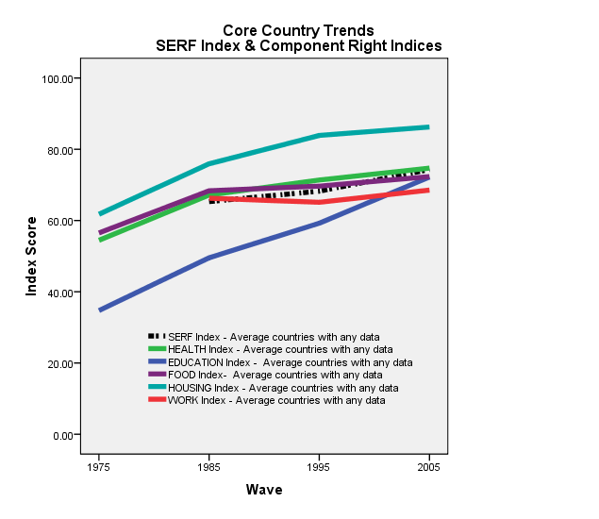
Core Historical SERF
Trends in Average Performance
Notes:
Although the wave 4 mean on the Core Country SERF Index was just under 75%, as the dashed black and white line shows, there has been progress. The mean score was just under 60% in 1975
Progress has been most rapid with regard to education (blue). The mean score on the education index has increased from 35% to 72%.
Progress has been most limited with regard to the right to work. There was a slight regress during the decade of the 1980s and only slight progress since then.
In general, progress was most robust during the 1970s. The percentage gain has been most limited for the right to health, and housing during the current decade.

Slide 21
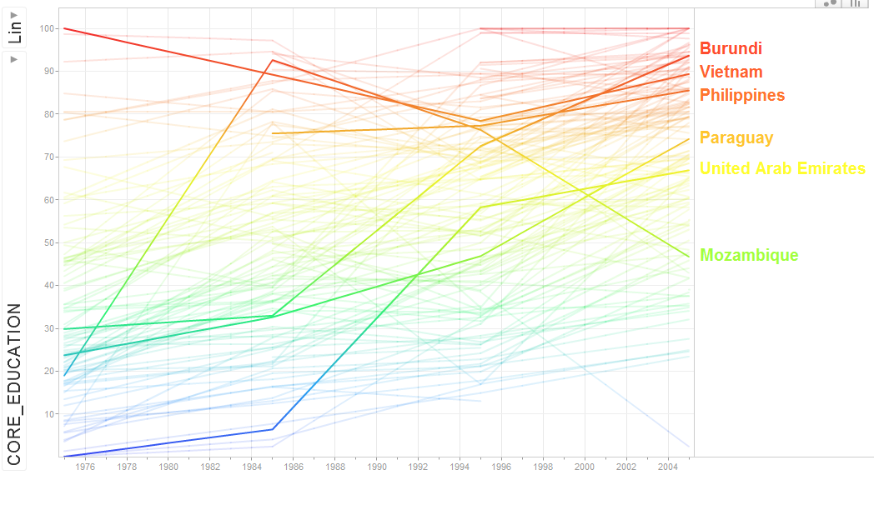
Core Education Index Trends
Notes:
There was wide variation in performance across countries on the SERF Index and each of its underlying components.
In addition, countries often showed progress in one decade and then regress in the next.
The principle of non-retrogression is frequently violated in the case of social and economic rights.
Retrogression occurred in half the countries on some right over a number of periods. Progress seems to occur in fits and starts.
The greatest gains are observed with regard to the right to education between 1975 and 1985 and there were phenomenal gains in some countries, YET nearly one out of ten countries suffered a decline in its education index over the period.
Here and in the following slides, I’ve just highlighted a selection of countries to give you a sense of these differences for each of the rights.

Slide 22
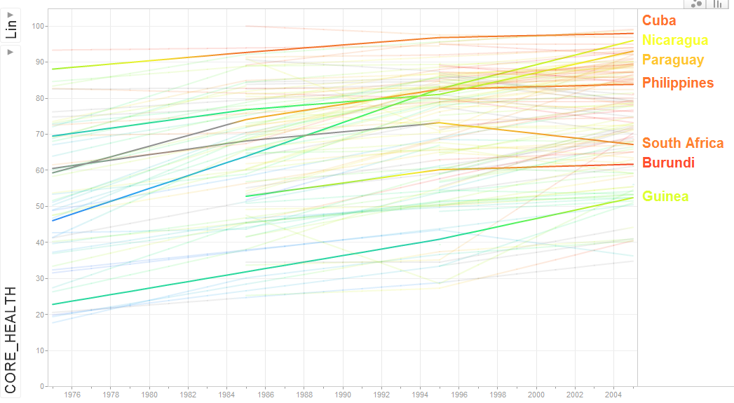
Core Health Index Trends
Notes:
For health, trends are less variable, but gains less pronounced.

Slide 23
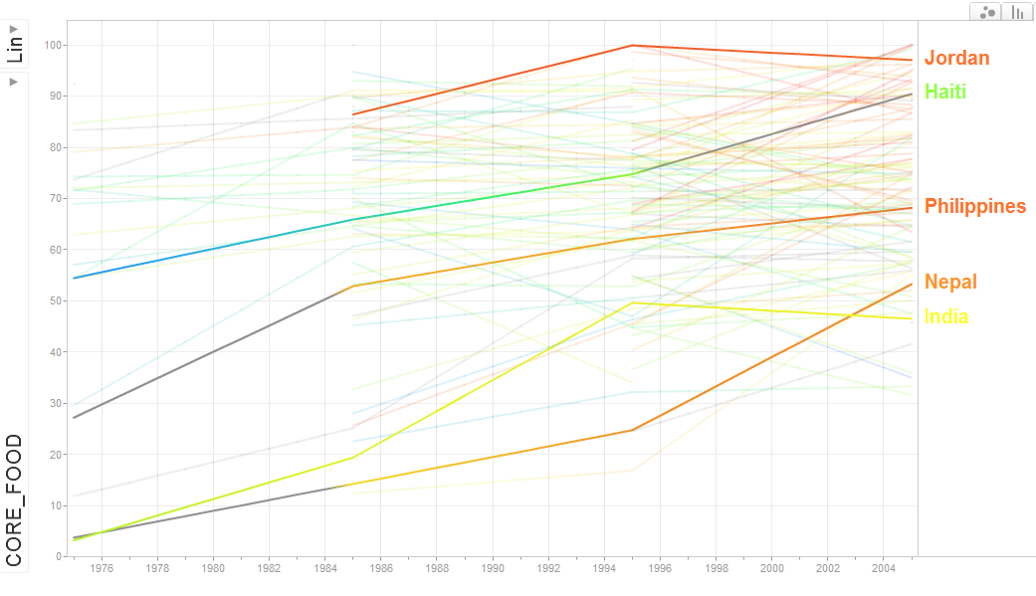
Core Food Index Trends

Slide 24
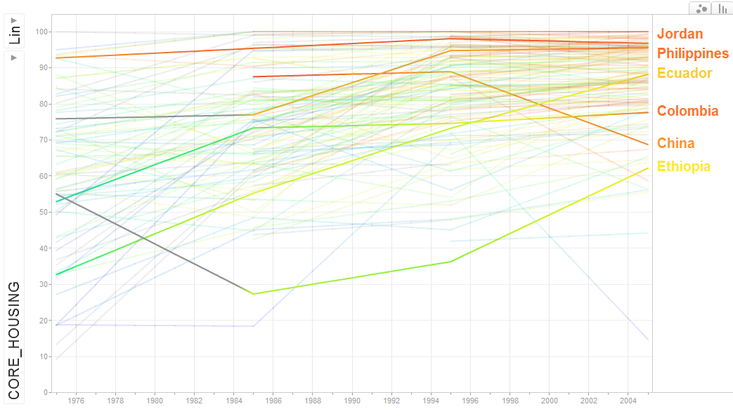
Core Housing Index Trends

Slide 25
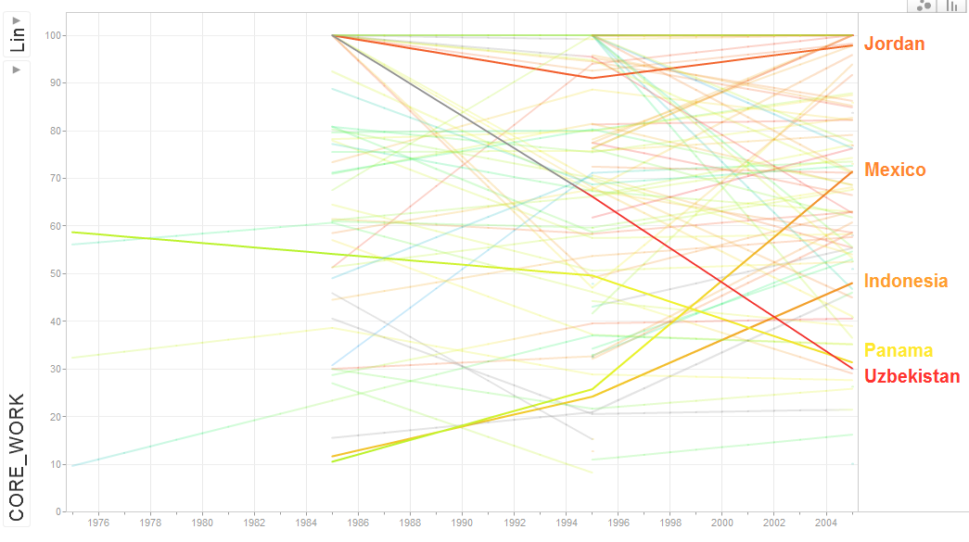
Core Work Index Trends

Slide 26
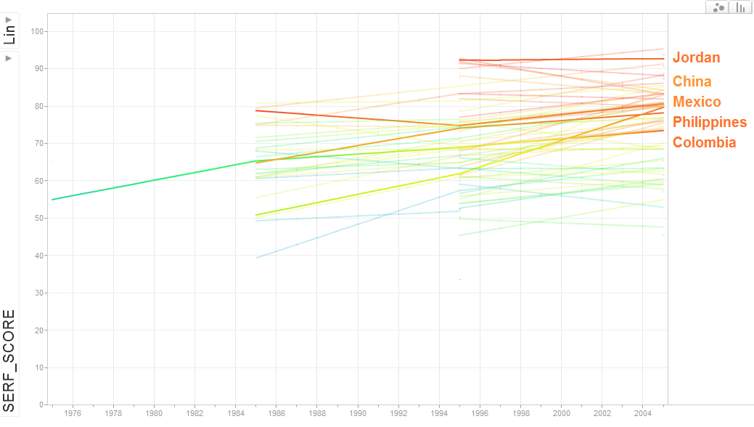
Core SERF Trends

Slide 27
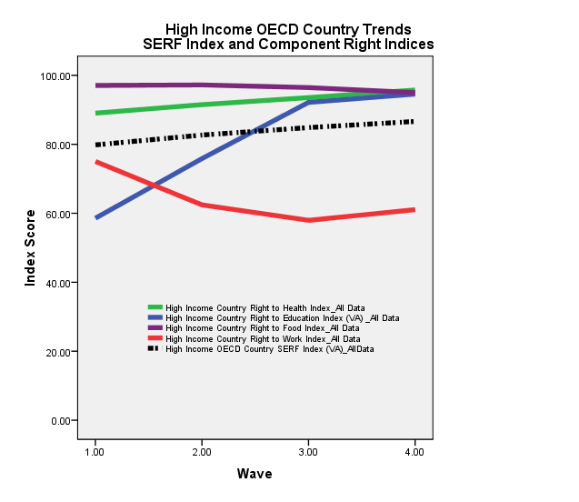
High Income OECD Country SERF
Trends in Average Performance
Notes:
High income OECD countries had a considerably higher SERF Index score some 40 years ago than core countries—80% versus 60%, but they too experienced progress over the subsequent 40 years –black & white dashed line)
The variation in performance across rights was greater at the outset for high income OECD countries, but as was the case for the core countries, the greatest gains are observed for the right to education.
For high income OECD countries, regarding the right to work, regress was the rule except during the most recent period when up until the recent global recession, a modicum of progress ensued.
High Income OECD countries increasingly fulfilled the right to health over the 40 years, but there was some erosion in the extent to which they fulfilled the right to food.
As was the case for the Core countries, High Income OECD countries exhibited considerable variation in performance between them, and as a rule, progress was uneven for each individual country.

Slide 28
Wave 3 Origins to Wave 4 Destinations
 | Below Median GDP Growth | Above Median GDP Growth
Above Median SERF | SERF Lopsided | Virtuous
Below Median SERF | Vicious | Growth Lopsided
31%
25%
46%
68%
17%
6%
6%
6%
8%
15%
67%
44%
44%
17%
Notes:
A key question is whether States that emphasize devoting current resources to meeting their economic and social rights commitments do so at the expense of generating additional resources that could enable even greater ESR enjoyment in the future.
One way to examine this is to divide countries in each period along two dimensions
Those with SERF Index scores above and below the median score and
Those with per capita GDP growth rates above and below the median growth rate across the decade.
Here we do this for the decade of the 1990s and the 200s
Countries that are in the bottom half of countries with regard to both their SERF Index score and their per capita GDP growth rate during the decade are caught in a vicious cycle if ESR are functional to growth.
Low SERF Index score → low per capita income growth →greater difficulty fulfilling ESR, etc.
Countries that are in the top half of countries with regard to both their SERF index score and their per capita GDP growth rate during the decade may be engaged in a virtuous cycle.
High SERF Index score → high per capita income growth → more resources to devote to fulfilling ESR.
Countries that are in the Southeast quadrant might be called growth-lopsided. They are prioritizing growth over meeting their commitments to fulfill their ESR commitments.
Countries that are in the Northwest quadrant might be called SERF-lopsided. They are prioritizing meeting their commitments to fulfill ESR over growth.
To gain some insight into:
whether countries get stuck in a vicious cycle
Whether countries that achieve the virtuous cycle have a good chance of remaining there,
and whether prioritizing growth over fulfilling ESR or prioritizing ESR over growth is more likely to enable countries to achieve the virtuous cycle,
We look at the transition paths across the decades.
Consider first countries in the vicious cycle in 1995
[Click ]Most (67%) remain in the vicious cycle
[Click ] 17% move into the SERF-lopsided quadrant
[Click] and an equal number move into the Growth-lopsided quadrant
[Click] none move into the virtuous cycle.
[click to remove all red circles]
Now consider countries in the Growth-lopsided quadrant
[click] 44% remain there in 2005
[click] but an equal number move into the vicious cycle
[click] 6% succeed in moving into the virtuous cycle
[click] and another 6% move into the SERF-lopsided quadrant
A growth first strategy doesn’t offer much prospect of fulfilling ESR over time
[click to remove all purple circles]
From the SERF-lopsided quadrant, the prospects of moving to the virtuous cycle are much better.
[click] 25% remain in the SERF-lopsided quadrant in the subsequent period
[click] but 68% move into the virtuous cycle
[click] the promise is not ironclad-6% move into the vicious cycle
[click] none move into the Growth-lopsided quadrant
[click to remove all black circles]
Once countries enter into the virtuous cycle, they are likely to stay there.
[click] Nearly half (46%) remained in the virtuous cycle
[click] while another 31% converted to the SERF-lopsided cycle offering good prospects to move back into the virtuous cycle in a subsequent period.
[click] 8% moved to the Growth-lopsided quadrant,
[click] while another 15% fell into the vicious cycle.
While clearly much more extensive analysis is needed, the evidence here suggests that countries that emphasize meeting their ESR commitments are unlikely to face reduced per capita income growth as a result
Quite the contrary, promoting economic and social rights may be good for growth.

Slide 29
Application to the United States
With
Michelle Prairie
&
John Stewart

Slide 30
Indicators of Rights Enjoyment Level by Right: International and State Versions
Social/Economic Right | International (High Income OECD countries) | US States
Right to Food | %Infants NOT low birth weight | %Food secure
Right to Education | Combined school enrollment rate Average math and science score (PISA) | Net secondary school enrollment rate; 4th and 8th grade, average math and reading NAEP scores
Right to Health | Child Survival Rate (%); Survival to Age 65 (%) | Child Survival Rate (%); Life Expectancy % Infants with normal birth weight
Right to Decent Work | % unemployed unemployed < 12 months; % with > 50% median income | 100% -Youth (20-24) unemployment rate; 100% - involuntary part-time employment rate; % with > 50% median income
Right to Adequate Housing | Data not Available | % renters spending < than 30% income on housing % School children not homeless
Right to Social Security | Data not available | % with Health Insurance % NOT Absolutely poor (US Standard)
Right to Equality and Non-discrimination |  | Data disaggregated by sex and racial/ethnic group
Notes:
A key advantage of country level case studies is that one can select from a wider range of socio-economic indicators.
Data are likely to be available on a wider range of right aspects that are particularly relevant to the country.
In our international assessment, comparable data are only sufficient to incorporate 4 rights. In our US analysis, however, we are able to incorporate all 6 rights.
We are able to use some indicators that better reflect what we are trying to measure—for example, the US collects data on food security that much better reflects the aspects of the right to food elaborated in General Comment 12 of the CESCR.
With regard to the achievement possibility frontiers, we used the international frontiers where feasible, but also estimated frontiers using historical data for all 50 states from the US.

Slide 31
ESRF Value by State
80-84.9%: 15 states | North Dakota, Wyoming, Montana, South Dakota, Idaho, New Hampshire, West Virginia, Nebraska, Maine, Vermont, Wisconsin, Iowa, Minnesota, Hawaii, Kansas
75-79.9%: 22 states
70-74.9%: 11 states | North Carolina, Colorado, Nevada, Mississippi, New Mexico, Arizona, Delaware, Alaska, Texas, Oregon, New York,
65-69.9%: 2 states | California, Louisiana
Notes:
So, how do different states in the US do?
No state is fully meeting its obligations.
The best performing state, North Dakota, falls short of the mark by over 15%.
Most states fulfill between 75 and 79% of their obligation.
Two states are fulfilling less than 65% of their obligation.
Higher ranked states tend to be small and have small minority populations while lower ranked states tend to be large and have more diverse population.

Slide 32
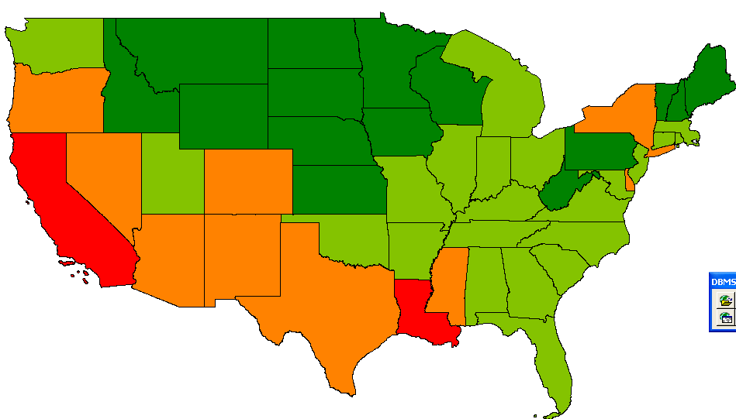
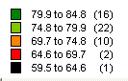
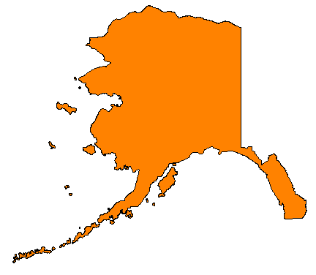
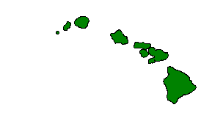
Notes:
There is marked regional variation.
The northern plains states and New England do best and the southwest does worst.
The “black” state is actually the District of Columbia—the Nation’s capital region. It does worst of all.

Slide 33
Right Component Index Ranges
Right | Index Range | # States >90% | # States <75% | Mean | Standard Deviation
Food | 68.1-86^ | 0 | 20 | 76.4 | 3.67
Education | 85.2-97.7% | 41 | 0 | 92.6 | 3.05
Health | 85.9-94.2% | 37 | 0 | 91.2 | 2.11
Decent Work | 62.7-79.5% | 0 | 39 | 71.6 | 4.01
Decent Housing | 11.2%-79.1% | 0 | 49 | 46.7 | 12.48
Social Security | 75.2%-92.1% | 9 | 2 | 86.1 | 4.1
Notes:
Again, we see variation in performance across rights.
States do best in fulfilling their obligations with regard to the rights to health & education: 41 states fulfill at least 90% of their obligations with regard to education and 37 do with regard to health.
The greatest deficiencies are observed for the right to Work and the right to housing. 39 of states fail to meet even 75% of the obligated value for the right to work, and 49 states fail to meet even 70% of their obligation for the right to decent housing.
By far, the greatest variation across states is observed for the right to Housing.

Slide 34
Incorporating Discrimination
Could not incorporate all rights given data limitations
  omit right to food & right to decent housing.
Sex discrimination:
  Right to health: only indicator available is child survival rate
Racial/ethnic discrimination:
  Right to health: omits life expectancy
  Right to education: only indicator available NAEP score
  Right to work: omits youth unemployment
Notes:
The data for the US were rich enough to allow us to look at the extent to which the principle of non-discrimination was been upheld, albeit only for 4 of the six rights, and with some loss in the aspects of certain rights incorporated for those rights included.
We looked at sex discrimination and racial discrimination.

Slide 35
Taking Discrimination Into Account
Correct Indicator Value for Discrimination
x^{D} = (1-ω) ΣP_{i}x_{i} + ωx₁
  X^{D} is the indicator value corrected for discrimination
  X_{i} is the value of the indicator for subgroup i
  i is an index for sub-group with i=1 assigned to the sub-group with the lowest score on the indicator
  P_{i} is the proportion of the population in sub-group i
The value selected for ω determines the emphasis placed on non-discrimination.
  If ω = 1 then the value of the indicator index equals the value of the indicator for the subgroup with the lowest score.
  If ω = 0 then there is no penalty for discrimination.
Notes:
We have a fancy formula that allows one to select the emphasis one wants to place on discrimination, but for our purposes here, I’ll just show the results placing the maximum emphasis on discrimination.

Slide 36
Sex Discrimination
(ω=1)
Overall, obligations are met to same extent for males and females.
  21 states females marginalized, 29 states males marginalized
  Difference never as great as 1%
Average hides differences in aspects of rights fulfillment
Notes:
In the aggregate we find there is minimal sex discrimination.

Slide 37
Sex Discrimination
  Education:
    boys marginalized,
    difference 3-4% reflecting quality dimension
  Health: boys marginalized but difference < 1%
  Work:
    women marginalized on decent wage aspect,
    but men marginalized on access dimension;
    in both cases diff 10% so overall only minor differences.
  Social Security: overall no difference but
    Men marginalized access health insurance by 5%
    Women marginalized absolute poverty by 5%
Notes:
However, the aggregate index hides some important differences.
With regard to education, boys are marginalized especially with regard to the quality of learning.
When it comes to the right to work the value of the index is essentially the same for men and women, but this hides large differences in dimensions of the right: scores are 10 points lower on the wage aspect for women, but 10 points lower for men on the access dimension
The same is true for the right to social security. Here men are marginalized when it comes to access to health insurance, but wome are marginalized when it comes to absolute poverty.

Slide 38
Racial/Ethnic Discrimination
Consider here 3-way classification:
  white, black, Hispanic
Aggregate Results:
  Pervasive violation right to non-discrimination.
  US seriously delinquent in its duty to respect, protect, & promote the economic and social rights of black Americans in particular.
    SERF index value adjusted for race/ethnic discrimination on average falls 10%
    Variation across states: California only falls 3%, Wisconsin & Missouri nearly 20%.
  Reflects substantial differences in value of indicators by ethnic group within any state
Notes:
Data limitations posed several additional problems: sample sizes for some ethnic groups on the indicators were so small within states that we couldn’t incorporate all states in the analysis.
Only able to calculate the full index for 26 states
Can calculate component right indicators for larger number of states: 1) education 36 states 2) health 43 states 3) work 36 states
4) social security 33 states.
However, the results are unambiguous. There are pervasive violations of the right to non-discrimination in the U.S. with regard to obligations of results.
The US continues to be seriously delinquent in its duty to respect, protect, and promote the economic and social rights of black americans in particular.
The aggregate SERF index value is 10 points lower for black americans on average—20 points lower in Missouri.

Slide 39
Racial/Ethnic Discrimination: Education
Fulfillment of right to education differs dramatically across ethnic groups
  Great divide: whites & Asians vs. others
  Marginalized group is blacks in most states, but Hispanics fare worst in 8 states.
Change in Education index value
  17 points on average
  Range -6% (New Mexico) to -30% (Wisconsin)
Notes:
We see even greater problems, and some surprises when we look at the separate right indices and underlying dimensions of each right.
For the right to education, the great divide is between whites and Asians on the one hand and blacks and Hispanics on the other.
The education index value is 17 points lower on average across the states, with a range of 6 to 30 points lower.

Slide 40
Racial/Ethnic Discrimination: Health
Differences in fulfillment of right to health not as marked as for right to education, but still substantial
  Blacks the marginalized group in all states
  Typically disadvantage is 8-10%, but varies from -4.9 in Hawaii to -12.6 in Wisconsin.
  Disadvantage of blacks is greatest on normal birth weight index (Hispanics fare best)

Slide 41
Racial/Ethnic Discrimination: Decent Work
This is the rights dimension that decreases the most upon incorporating non-discrimination
  Average decrease is 20%
    Fell by between 35% & 45% in Iowa, Missouri and Washington State
  Great divide is between whites & all others
  Differences in marginalized group across dimensions
    Decent pay: Blacks most marginalized
    Security and work environment: Hispanics fare worst
Notes:
US performance on Right to Decent Work is lower than on any other component rights. One might hope discrimination was not as marked along this dimension, but that is not the case.
On average, this index falls by 20 points when incorporating discrimination; but it is between 35 and 45 points lower in 3 states, and those aren’t the states where we think racism is most prevalent.
The divide is between whites and all other groups with blacks faring worst when it comes to decent pay and Hispanics faring worst when it comes to work security and work environment.

Slide 42
Racial/Ethnic Discrimination: Social Security
This rights dimension decreases nearly as much, just under 20%, upon incorporating non-discrimination.
  Variation across states -12.2% (California) to -33.9 (Delaware)
  Hispanics fare worst
  Hispanic disadvantage most strongly related to lack of health insurance
  Absolute poverty disadvantage (post transfers) not as great as that for health insurance.
Notes:
The extent of violation with regard to non-discrimination is nearly as pronounced for social security, only here Hispanics are uniformly the most marginalized group.

Slide 43
THANK YOU

Slide 44
EXTRA SLIDES

Slide 45
Wave 3 Origins to Wave 4 Destinations
 | Below Median GDP Growth | Above Median GDP Growth
Above Median SERF | SERF Lopsided | Virtuous
Below Median SERF | Vicious | Growth Lopsided
16 W3 countries had W4 status of:
68.8% Virtuous
25.0% SERF lopsided
6.3% Vicious
0.0% Growth Lopsided
13 W3 countries had W4 status of:
46.2% Virtuous
30.8% SERF lopsided
15.4% Vicious
7.7% Growth Lopsided
13 W3 countries had W4 status of:
66.7% Vicious
16.7% SERF lopsided
16.7% Growth Lopsided
0.0% Virtuous
16 W3 countries had W4 status of:
43.8% Growth Lopsided
43.8% Vicious
6.3% SERF lopsided
6.3% Virtuous

Slide 46
Core Countries
Average % Gain by decade
 | 1975-85 | 1985-95 | 1995-2005
Health | 23.3 | 6.3 | 4.7
Education | 42.7 | 20.2 | 21.8
Food | 20.9 | 1.9 | 3.8
Housing | 22.9 | 10.5 | 2.8
Work | - | -1.7 | 5.3
SERF | - | 4.5 | 8.9

Slide 47
High Income OECD Countries
Average % gain by decade
 | 1975-85 | 1985-95 | 1995-2005
Health | 2.8 | 2.2 | 2.4
Education | 29.5 | 21.5 | 2.6
Food | 1.5 | 0.8 | -1.5
Work | -16.8 | -8.2 | 5.4
SERF | 3.6 | 2.8 | 2.1

Slide 48
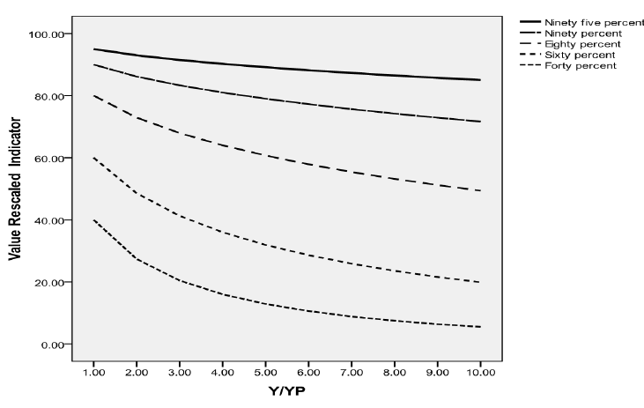
Formula F
Adjustments for Observed Achievements of 40, 60, 80, 90, and 95% at Income Ratios Up to 10.

Slide 49
Adjustment for Countries Capable of Fulfilling Right
If Y>Yp, the per capita income level where it is feasible to achieve 100% on possibilities frontier (see graph)
And the country’s achievement on the indicator is less than 100%,
Then x% is adjusted: a penalty is subtracted from the achieved index value so that:
  X* = (x% - penalty)/100%
  The penalty increases by factor related to Yp as per capita income increases
100
Frontier=100%
x
% Achievement on Rights Indicator
50
0
y_{p}
y
0
GNP per capita

